Slide 1

UNIVERSAL CAR WASH
ECON 401

Slide 2
Group Members
Name | Enrollment no.
Aman Khandelwal | U101116FCS007
Ashish Bhist | U101116FCS015
Mitul Kumar | U101116FCS068
Rishabh Gaur | U101116FCS100
Shashwat Shah | U101116FCS112

Slide 3
ABOUT US
Universal Car Wash is a state of the art automatic and manually operated car services center based in Neemrana, Rajasthan.
We offer various utility and maintenance services which are handled and operated by experience experts.
We aim to provide on-the-go car services to tourist en route using The National Highway 8 and to the local citizens.
This application aims to ease customers and to facilitate owner.

Slide 4
Features
1.User can view Services without login as Guest user.
2.User can Book services by registering in the app by entering their number
3.User can view waiting status of their car
4.User can give feedback
5.User feedback and waiting status will be managed by admin app which will be only available to the client

Slide 5
SERVICES OFFERED
1. Exterior and Interior car wash
2. Interior Dry Cleaning
3. Rubbing /Shining
4. Rubber Coating
5. Teflon Coating

Slide 6
For Registered Customers
1. Log in using your registered mobile number and the One-time-Password (OTP) Generated.
2. From the Home Tab select the “Index” button on the top left column
3. Select “Services” from the List and click on the desired service from the Viewed page.
4. Confirm your booking and enter your car’s number in the correct Format and Click book now.
Your Car number and the desired service will be registered
5. Now when you drop off your vehicle at the UCW center you can view the status of your
car by clicking on the “Waiting list” button in the Home page.

Slide 7
For Guest users
NOTE – Guest users have to register within the Application to exploit the services.
1. Click on the “View Services as Guest login” in the bottom of the page to view the
Services.
2. Select desired service

Slide 8
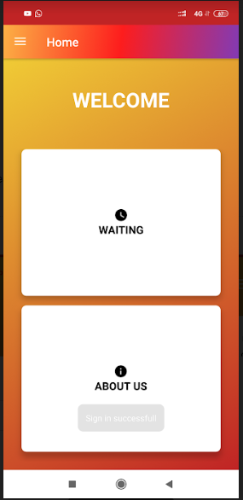
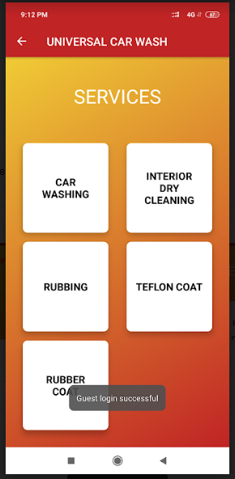
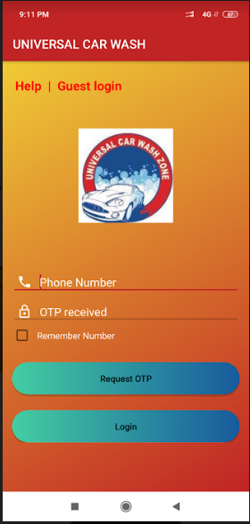
Screenshots of App

